Slide 1
Council-2 Readout IRCC June 3, 2019
Chair Rear Admiral Shepard M. SMITH (USA)
Vice-Chair Adm (Ret) Luiz Fernando PALMER Fonseca (Brazil)
Secretariat Dr. Mathias JONAS, Secretary-General (IHO Secretariat)

Slide 2
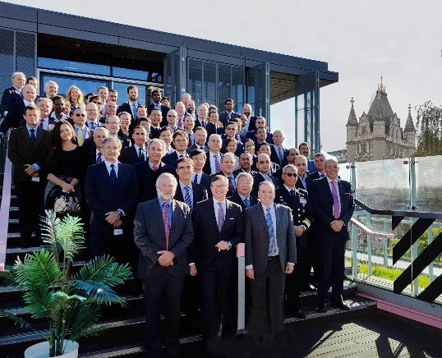
Overview
Council-2
October 9-11, 2018, London
28 Council Members and 10 IHO MS Observers
(SWPHC participants: Australia, France, UK, USA)
Key Agenda items
Strategic Plan Review Working Group Report
S-100 Product Provision
Crowdsourced Bathymetry Working Group Guidelines
Seabed 2030
Preparations for Council-3 and Assembly-2
Other

Slide 3
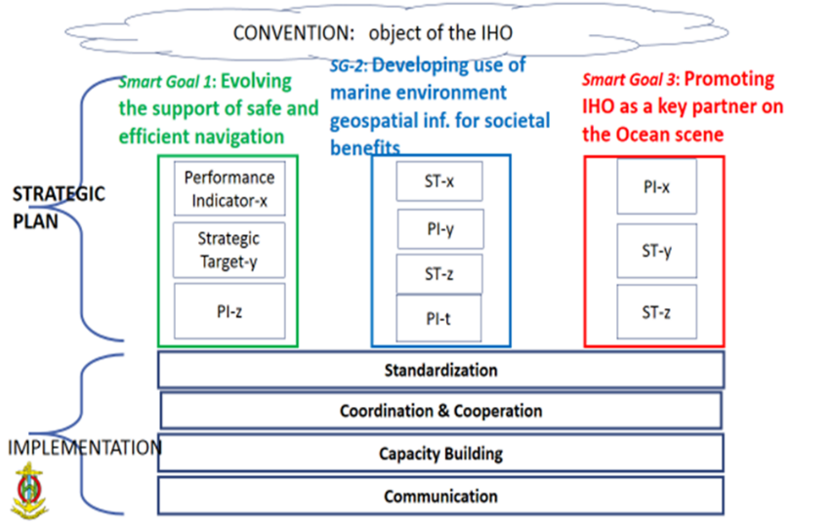
Strategic Plan
July 2019
proposed new Strategic Plan submitted for Council 3
Notes:
The report of the SPRWG Chair and subsequent discussions were important elements of the Council 2 meeting. The Council needed to come out of the C-2 with sufficient guidance to the SPWRG so that it could progress its task on behalf of the Council as requested by Assembly-1.
After good discussion, the C-2 adopted 3 SMART Goals around which to organize a drafting effort. THe ultimate plan is intended to be fairly short- on the order of 3 pages or so and very high level.
A Management Plan was adopted with an associated timeline of actions. The SPRWG will meet in late January to begin drafting the plan, the IRCC and HSSC Chairs will be invited to weigh in on performance measures and targets, the SG of the IHO was added to the membership of the SPRWG. The document will be reviewed again over the summer in connection with the IRCC and HSSC meetings. See C2-6.1
A proposed draft revised plan will be submitted to Council-3 in July/August. C-3 will deliberate and if accepted, the plan will be finalized for consideration at Assembly-2. For that, the plan will need to be submitted in December 2019, in advance of A-2 in April 2020.
Chair: bruno.frachon@shom.fr
Vice Chair: shigeru.nakabayashi@jodc.go.jp
Secretariat: douglas.brunt@dfo-mpo.gc.ca

Slide 4
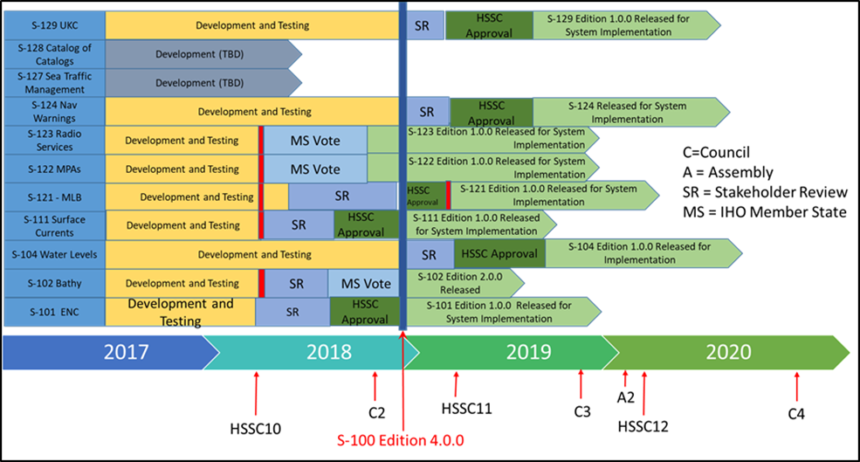
Development and Future Provision of S-100 Products
Notes:
Action C2/31:
Council, HSSC, IRCC Chairs and Secretary-General to draft an implementation strategy aiming to the regular and harmonized production and dissemination of S-100 based products for further discussion at A-2 and for the preparation of the 2021-2023 IHO Work Programme. (deadline C-3 in preparation for A-2)
Action C2/30:
IRCC to instruct and provide guidance to the WENDWG in order to investigate the applicability of the WEND-like Principles to the production and dissemination of S-101 ENCs and the first generation of S-100 based products and to report back at C-3. (deadlines: Dec. 2018, C-3)

Slide 5
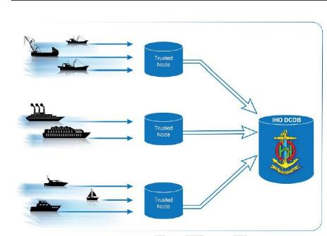
Crowdsourced Bathymetry
B-12 - IHO Guidelines on Crowdsourced Bathymetry Edition 1.0.0 Adopted
Further work is needed for depicting the data flow (sensor, coastal States information, DCDB) before these guidelines can come into force with full effect. Action to IRCC

Slide 6
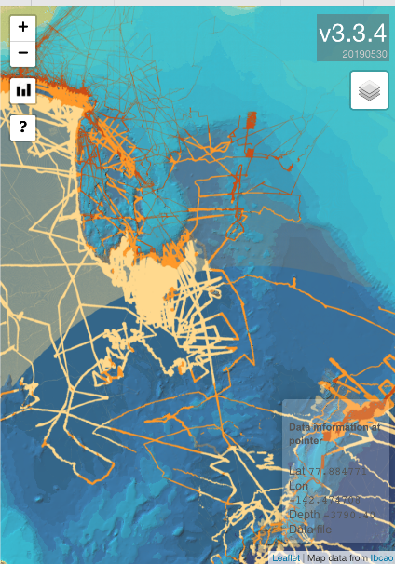
Seabed 2030
Presentation from Dr. Graham Allen, acting SB2030 project director
While his presentation was well received, there was no formal action from the Council in response.
Note proposal to IRCC to follow in the agenda to engage the RHCs in Seabed 2030.

Slide 7
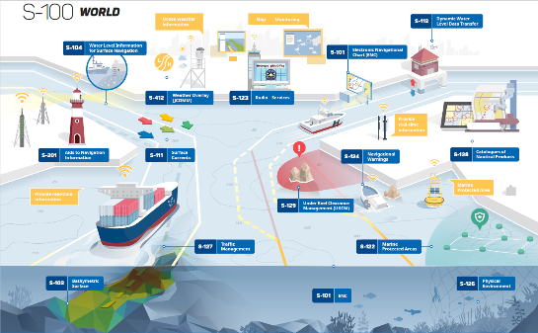
Provision of S-100 Services
Broad discussion of a strategy for provision of S-100 services led to two council decisions:
C2/30. WEND to consider WEND-like principles applicable to S-100 services. This has already been introduced by the WEND.
C2/31. SG, Council Chair, IRCC Chair, and HSSC Chair to draft a roadmap for provision of S-100 services for Council 3.

Slide 8
IHO Communications
New logo
Revamping of website and IHR
IHO-100 Centenary
Social media (LinkedIn, YouTube, etc…)
World Hydrography Day 2019:
“Hydrographic information to drive marine knowledge”
Notes:
RES 2/2007, 1/2005, 2/1997 (RHCs), 6/2009 (IHR), 1/2018 (ENC Overlaps)
Council Rules of Procedure/Protocols of Convention
Work Program and Budget adopted
Not addressed in this summary:
IRCC and HSSC Work Program, ROPs, and priorities (covered by others)
Updated of selected Resolutions (to be raised elsewhere in the agenda)
RES 2/2007, 1/2005, 2/1997, 6/2009, 1/2018

Slide 9
Countdowns for HSSC, IRCC, Council, Assembly by 2020
May/June 2019
July 2019
*See C2 meeting document (C2.7)
HSSC11, IRCC11
Report/Prop. to C-3
Aug. 2019
Oct. 2019
Nov. 2019
Red Book C-3
Council-3
Report/Prop. to A-2
21 Oct. 2019
21 Dec. 2019
21 Feb. 2020
21 Apr. 2020
Prov. Agenda A-2
Proposals to A-2
Rev. Prov. Agenda&
Red Book A-2
Assembly-2
Notes:
This is a graphic offered by the IHO at Council-2. I offer it as illustrate of the tight timelines we have coming up in 2019 in preparation to Assembly-2. Robust preparations, deliberations, and reports and recommendations from IRCC, HSSC, and Council will be the key to a timely preparation for Assembly 2.

Slide 10
Thank you

